Slide 1
Graphs and Graphing Algorithms
Problem Solving with Algorithms & Data Structures Using Python

Slide 2
Objectives
To learn what a graph is and how it is used
To implement the graph abstract data type using multiple internal representations
To see how graphs can be used to solve a wide variety of problems

Slide 3
Graphs
A general structure
Can be used to represent many things in our world
Systems of roads
Airline flights
The internet connectivity

Slide 4
Vocabulary and Definitions
Vertex
A vertex is a fundamental part of a graph
It can have a name (key) and may also have additional information (payload)
Edge
Another fundamental part of a graph
An edge connects two vertices to show that there is a relationship between them
May be one-way or two-way
Weight
Edges may be weighted to show that there is a cost to go from one vertex to another
Path
A path in a graph is a sequence of vertices that are connected by edges
Cycle
A cycle in a directed graph is a path that starts and ends at the same vertex
A graph with no cycles is called an acyclic graph
A directed graph with no cycles is called a directed acyclic graph (DAG)

Slide 5
Graph ADT
Graph()
Creates a new empty graph
add_vertex(vert)
Adds an instance of Vertex to the graph
add_edge(from_vert, to_vert)
Adds a new directed edge to the graph that connects two vertices
add_edge(from_vert, to_vert, weight)
Adds a new weighted directed edge to the graph that connects two vertices
get_vertex(vert_key)
Finds the vertex in the graph named vert_key
get_vertices()
Returns the list of all vertices in the graph
in
Returns True for a statement of the form vertex in graph if the given vertex is in the graph, False otherwise

Slide 6
Graph Implementation
Adjacency matrix
Adjacency list
Using dictionaries in Python

Slide 7
Breadth-First Search

Slide 8
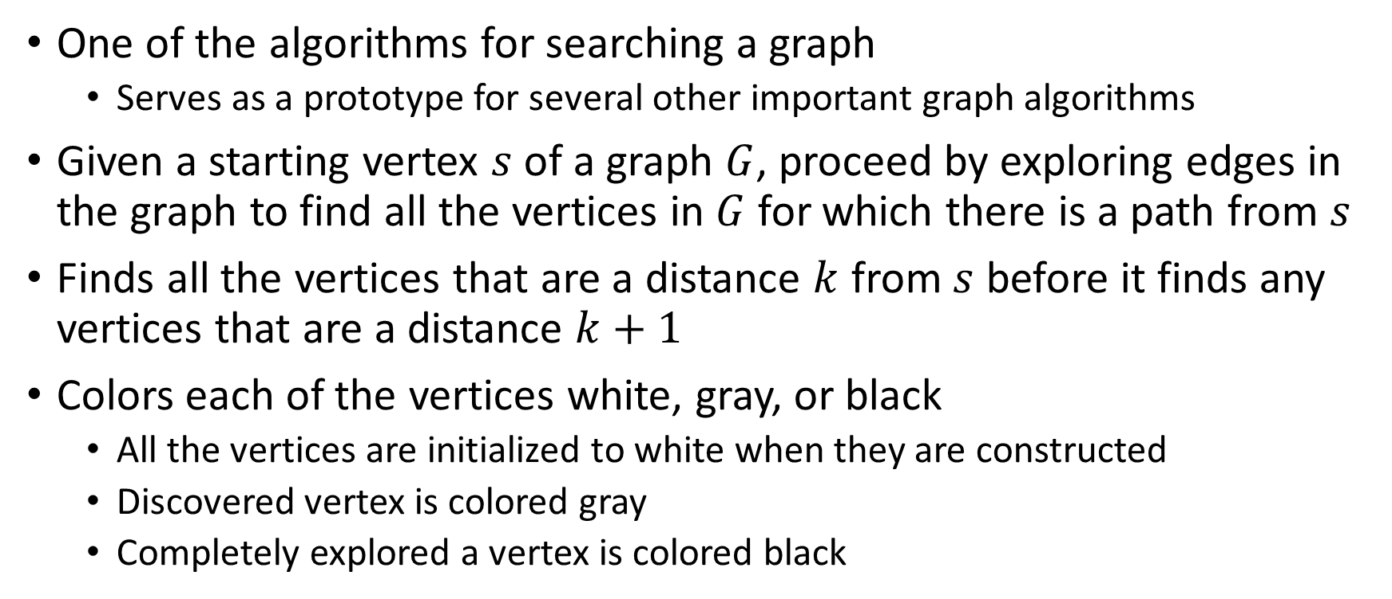
Breadth-First Search
One of the algorithms for searching a graph
Serves as a prototype for several other important graph algorithms
Given a starting vertex $s$ of a graph $G$, proceed by exploring edges in the graph to find all the vertices in $G$ for which there is a path from $s$
Finds all the vertices that are a distance $k$ from $s$ before it finds any vertices that are a distance $k+1$
Colors each of the vertices white, gray, or black
All the vertices are initialized to white when they are constructed
Discovered vertex is colored gray
Completely explored a vertex is colored black

Slide 9
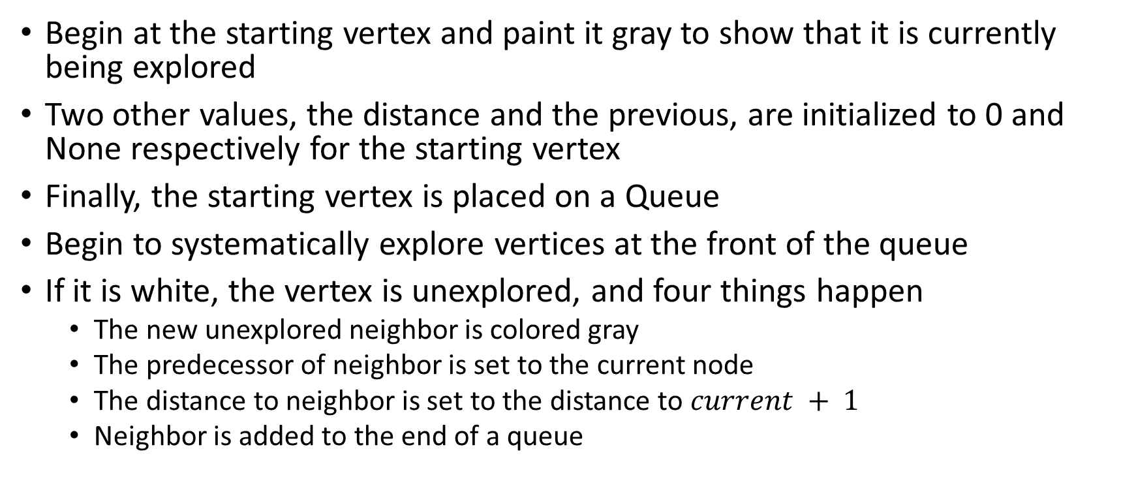
Breadth-First Search
Begin at the starting vertex and paint it gray to show that it is currently being explored
Two other values, the distance and the previous, are initialized to 0 and None respectively for the starting vertex
Finally, the starting vertex is placed on a Queue
Begin to systematically explore vertices at the front of the queue
If it is white, the vertex is unexplored, and four things happen
The new unexplored neighbor is colored gray
The predecessor of neighbor is set to the current node
The distance to neighbor is set to the distance to $current + 1$
Neighbor is added to the end of a queue

Slide 10
Depth-First Search

Slide 11
Depth-First Search
Creates a search tree by exploring one branch of the tree as deeply as possible
Uses colors to keep track of which vertices in the graph have been visited
Unvisited vertices are colored white, and visited vertices are colored gray
Start with a single start vertex and explore all of the neighboring white vertices as deeply as possible
The algorithm is almost identical to breadth-first search except DFS is recursive (uses stack implicitly), whereas BFS uses a queue

Slide 12
Shortest Path Problems

Slide 13
Shortest Path Problems
Finding the shortest route between cities
Finding the shortest route between internet routers
Finding the shortest path, one with the smallest total weight along which to route any given message in a graph

Slide 14
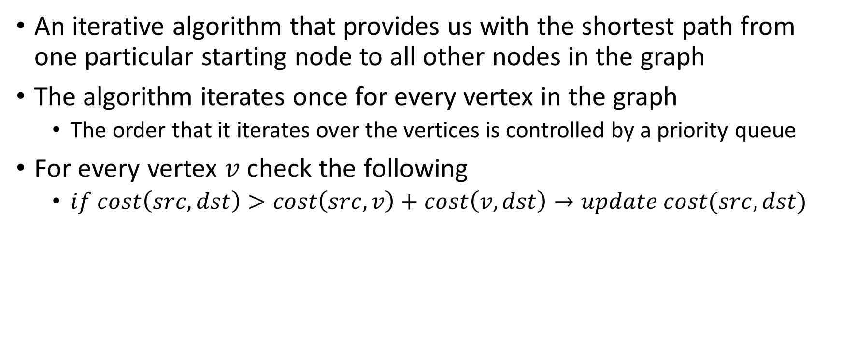
Dijkstra’s Algorithm
An iterative algorithm that provides us with the shortest path from one particular starting node to all other nodes in the graph
The algorithm iterates once for every vertex in the graph
The order that it iterates over the vertices is controlled by a priority queue
For every vertex $v$ check the following
$if cost\left(src,dst\right)>cost\left(src,v\right)+cost\left(v,dst\right)→update cost(src,dst)$

Slide 15
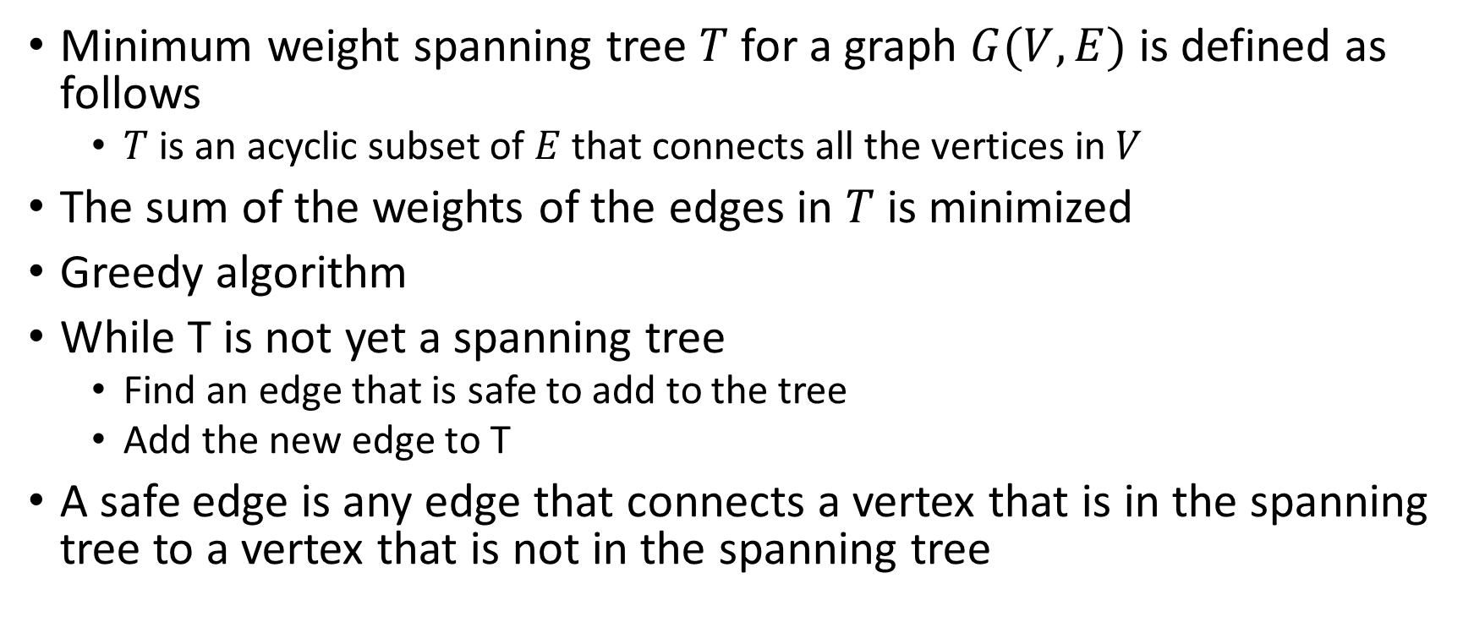
Prim’s Spanning Tree Algorithm
Minimum weight spanning tree $T$ for a graph $G(V,E)$ is defined as follows
$T$ is an acyclic subset of $E$ that connects all the vertices in $V$
The sum of the weights of the edges in $T$ is minimized
Greedy algorithm
While T is not yet a spanning tree
Find an edge that is safe to add to the tree
Add the new edge to T
A safe edge is any edge that connects a vertex that is in the spanning tree to a vertex that is not in the spanning tree

Slide 16
Summary
Breadth-first search for finding the unweighted shortest path
Dijkstra’s algorithm for the weighted shortest path
Depth-first search for graph exploration
Strongly connected components for simplifying a graph
Topological sort for ordering tasks
Minimum weight spanning trees for broadcasting messages

